Slide 1
PhotoTK
Sprint2

Slide 2
Brief recap on our project
We are making the photoTK that has ton of features in it, so photographer don’t need to download or use a lot of different apps, and do lots of research when trying use camera to take a high quality photo.
For sprint 1 we managed to create a not functioning login feature by firebase and a very simple layout for UI with map feature and EXIF info of a photo.
Features including : map (geolocation record), weather, calculator, gear managements, EXIF info and celestial event.

Slide 3
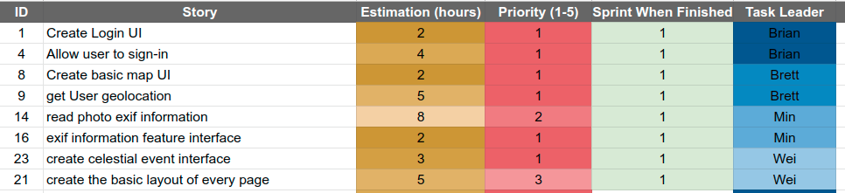
What we accomplished on Spring 1(Backlog)

Slide 4
Accomplishment for Sprint 2
A better looking UI
Weather feature
User register/login feature
User sign in/ out feature
Camera gears management feature
Add / update / delete gears in DB
Local celestial event searching feature

Slide 5
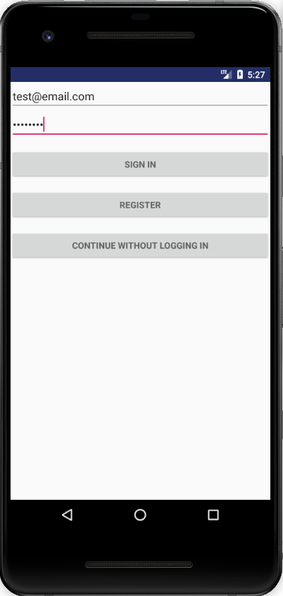
Login and Registration
DONE:
Create Account
Sign-in
Sign-out
TODO:
Delete Account
Recover Forgotten Password
Change Password

Slide 6
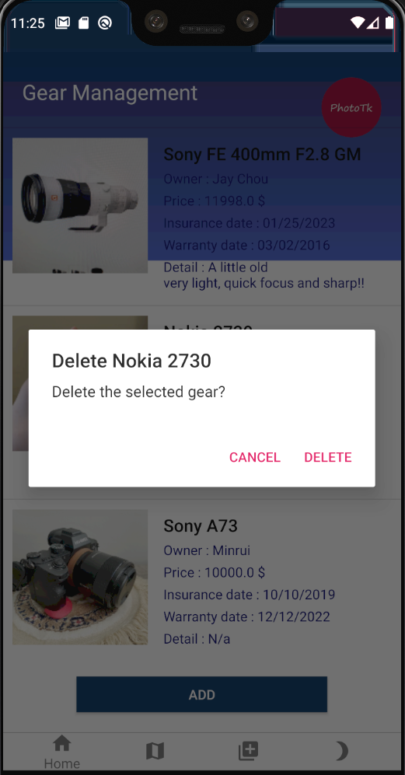
Camera Gear Management
Done this feature with firebase realtime database. This feature is to let users push camera gears info into our database:
Add a gear by clicking “Add” button.
Update a gear by clicking a gear in the list.
Delete a gear by long holding it. (shown at right)
For now the database is shared and public, so adding a gear owner category can be for letting other people to borrow from them or showing off their gears, and also it’s easier to let other photographer know what kinda gear set to aim for.

Slide 7
Home page , UI and Navigation Bar
On Sprint One we do not have a proper Home page no UI and No navigation bar to navigate between different function.
Sprint two we have a proper home page, and unified UI and a bottom navigation bar. I also add a dark mode into the system. Some android user can benefit the darkmode by turn on the darkmode in the phone system setting.

Slide 8
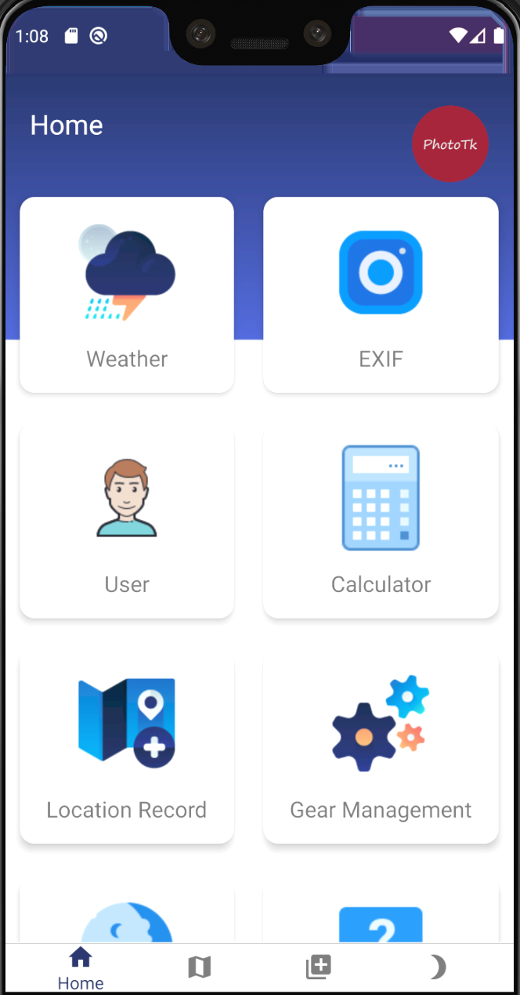
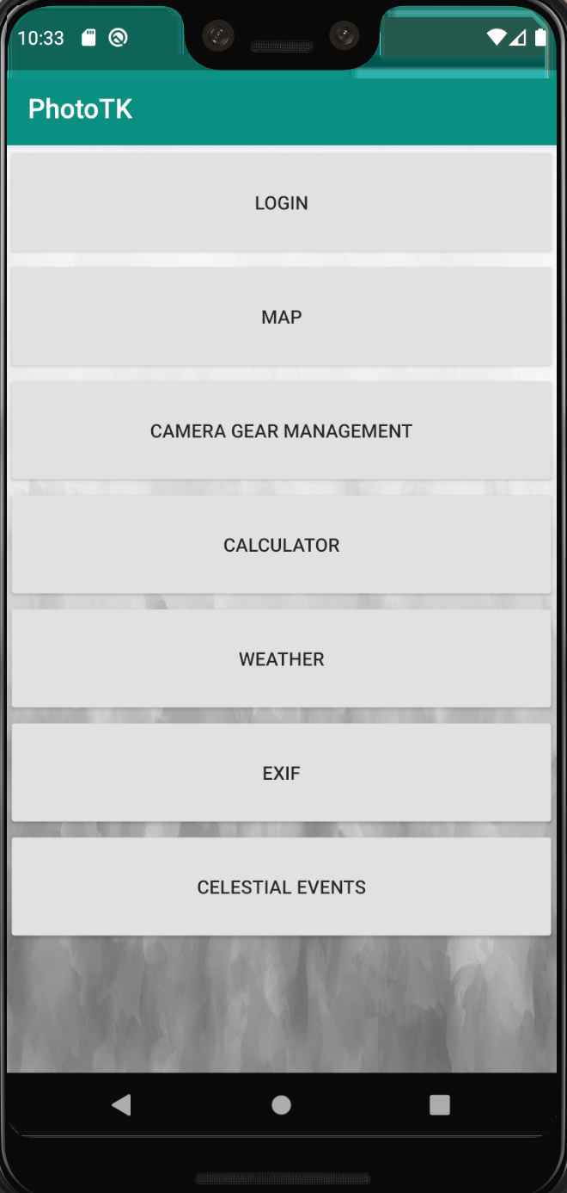
Why we choose this design
We went for a big icon design with bottom navigation. The main reason we choose this design because it is easier to use than a hamburger style. Photographer offen face under harsh condition and some of than could not used phone very well. A big icon and always on the bottom navigation bar could help then switch the function easily. In addition big icon is glove friendly. So you can click the bottom with glove on without worried about missing the click.

Slide 9
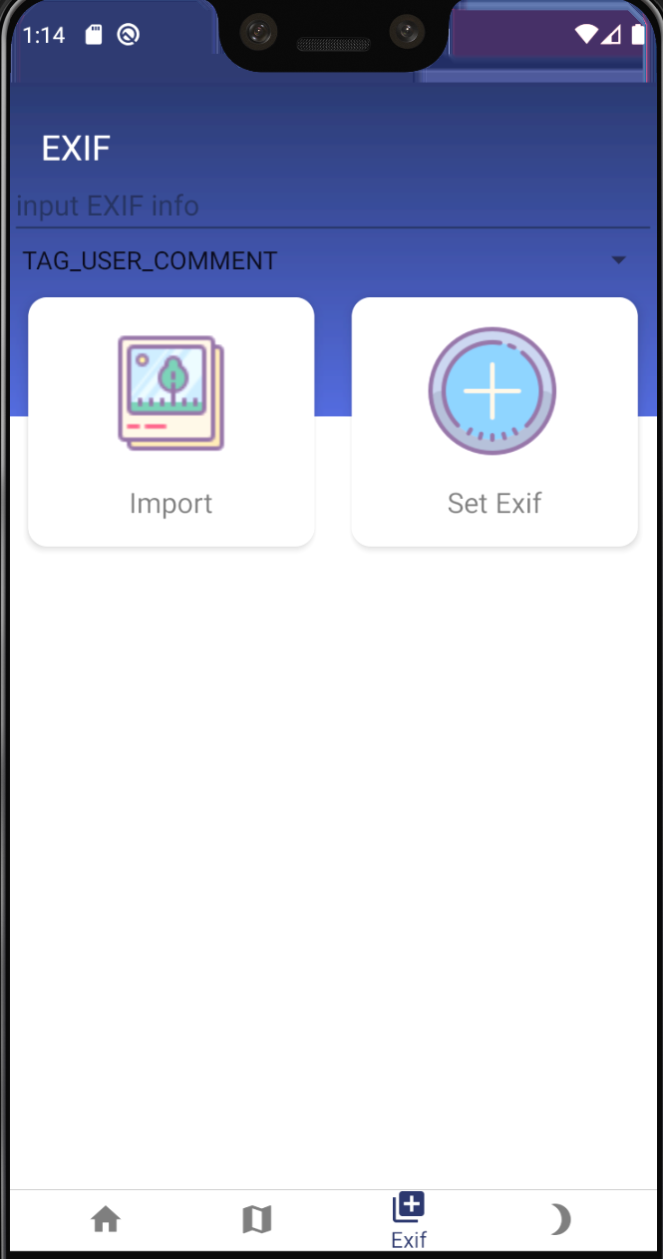
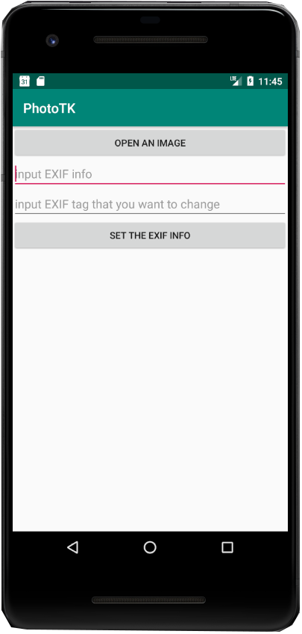
EXIF
On Spring 2 I add the spinner to let user to pick which area of the exif they want to change. In addition I unified the UI design.

Slide 10
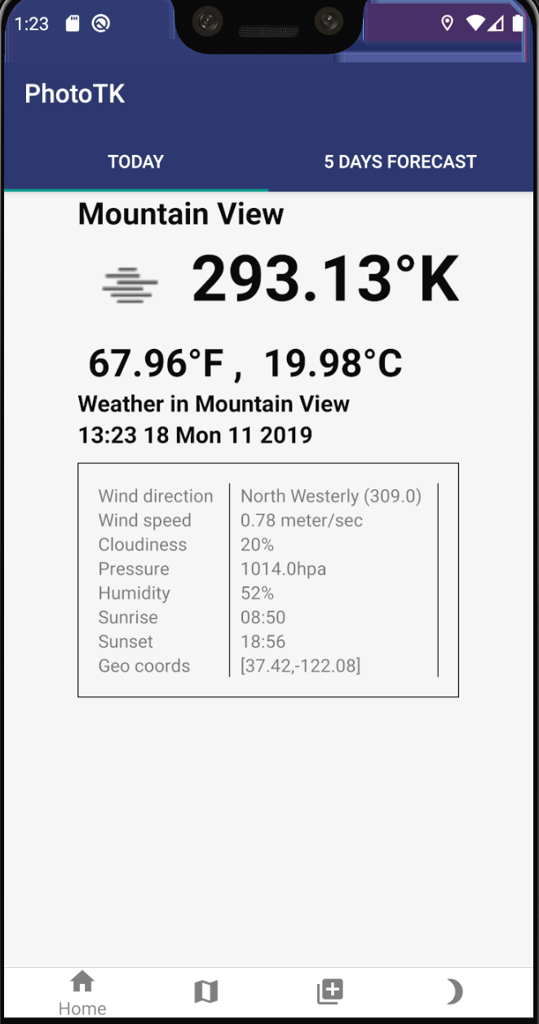
Weather
Weather feature is the new feature worked on Spring2. We use openweathermap. We only used free function from the api. So the feature is limited. We provide three different type of unit in temp. Kelvin for the scientist, F for American and C for everyone else lol. We also include 5 day forecast.

Slide 11
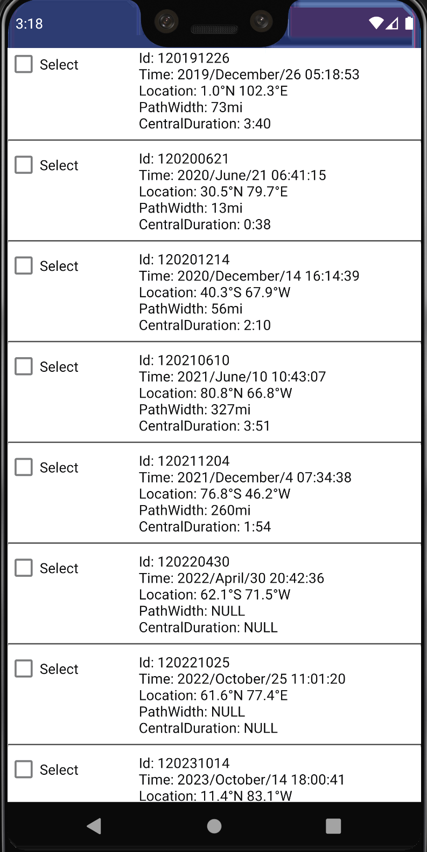
Celestial
On sprint one, the celestial event page does not have a good interface design. I updated the interface and modified the layout. The checkbox which can save the status of special information sometimes had some errors on sprint one. Now it works well and has a clear interface.

Slide 12
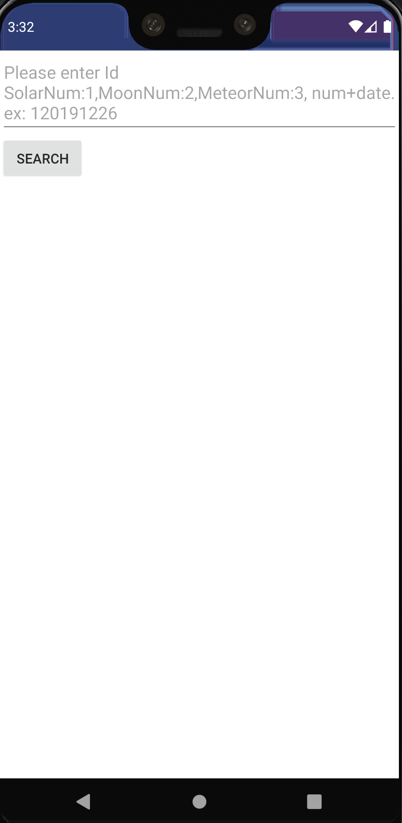
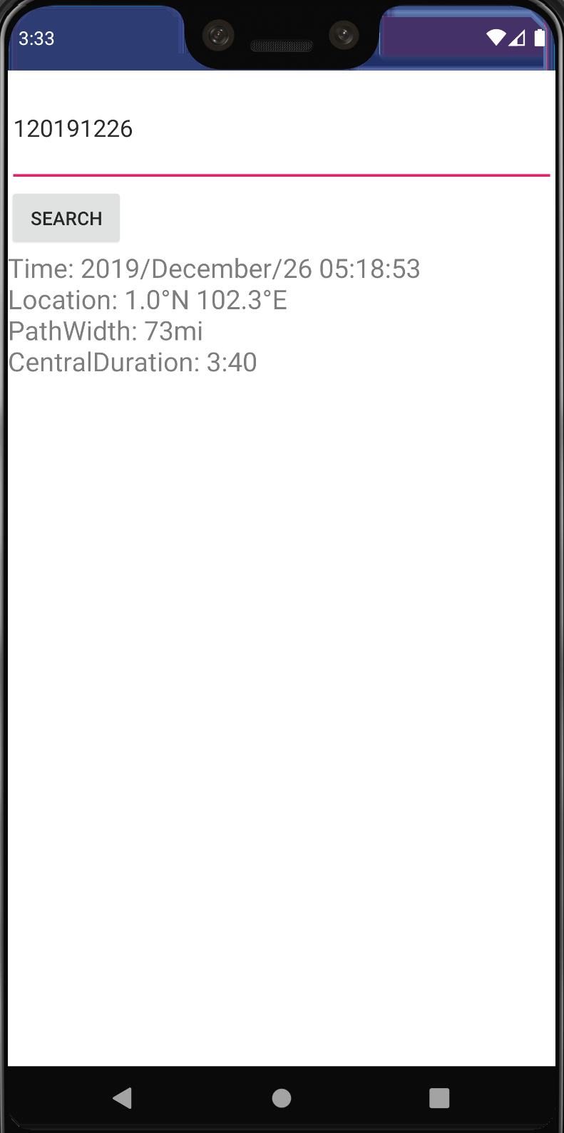
Local search function
On sprint two, I add a search function in celestial event page. This function can allow users to find the information they want efficiently. For example, if a user intend to know if there is a special celestial event today before taking a photography, this search function will be helpful. The user can type the date number to search the result. Now there are three kinds of celestial event.

Slide 13
Challenges face on Sprint 2
Working with openweather API is a challenge.
App keeps crashing when setting up child event listeners so it will be sync when some actions are done in Database.
Facing lots of problems when making the class parcelable, so it can be wrapped up and throw into another activity.

Slide 14
What we will be accomplished on Sprint3
Write Exif, search by the cities in forecast and about page.
Calculator, Forgotten/ Change password, Map location record and debug any potential bug.
Make a video and finish the website.
The celestial event search function will be updated to work better in the future.

Slide 15
Test Cases:
Test case 1: testing if long clicking an item in a list, the alert dialog of "Delete the selected gear?" would pop up.
Test case 2: This test case is to test the UI pages.
First we test it the home pages is launch, then we test if the other activities launched when onclick. We choose exif as a sample. If the exif activity active onclick then the test case passed.
Test case 3: test if the checkbox is check for celestial event

Slide 16
Demo
Any Question or Suggestion?

